Slide 1
Permission Slips

Slide 2
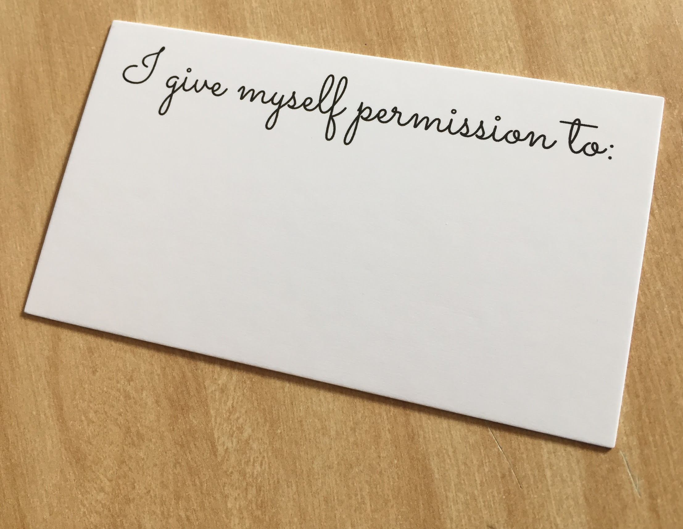
“We’re not going to recognize emotion if we don’t feel like we have permission to feel emotion. Writing down permission becomes a powerful intention to stay aware. It will give you the opportunity to be your most authentic self. We are wired to be emotional beings. When that part of us is shut down, we’re not whole.”
~Dr. Brene Brown excerpt from “Rising Strong”

Slide 4
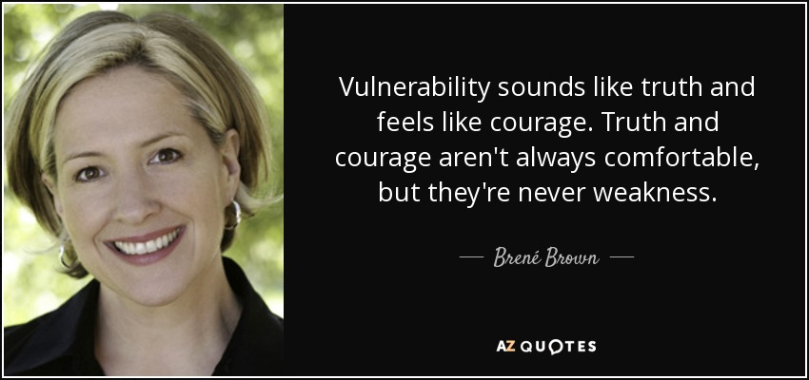

Slide 5
What does brave or bravery mean?

Slide 6
What are some professions or jobs where you have to be brave?

Slide 7
ARTISTS!!

Slide 8
Permission Slips:
Who normally gives you permission to leave school early for a doctor’s appointment?

Slide 9
Permission Slips:
Who normally gives you permission to leave school early for a doctor’s appointment?
Who gives you permission to leave the classroom?

Slide 10
Permission Slips:
Who normally gives you permission to leave school early for a doctor’s appointment?
Who gives you permission to leave the classroom?
Is there anyone you GIVE permission to?

Slide 11
Permission Slips:
There actually is someone very important that you can give permission to.
Do you know who that person is?

Slide 12
Permission Slips:
There actually is someone very important that you can give permission to.
Do you know who that person is?
YOU!

Slide 13
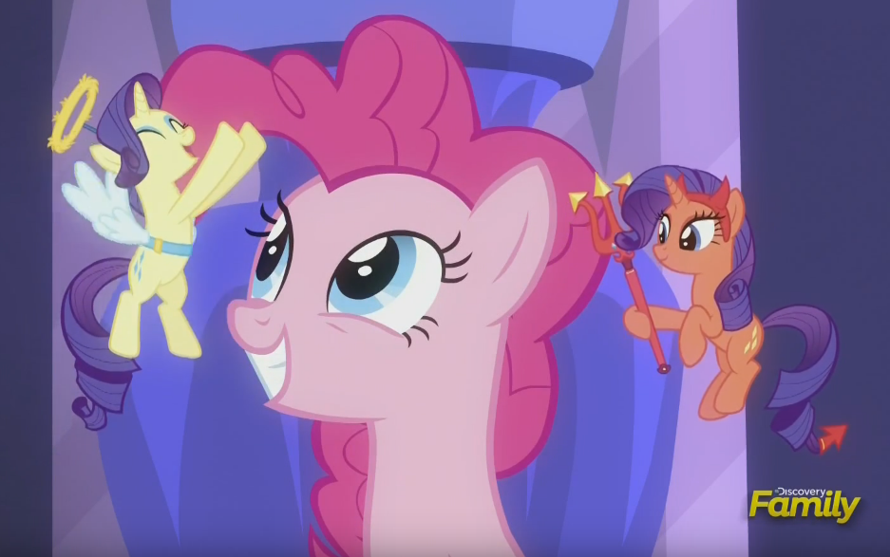
Permission Slips:
Choose to use your powers for GOOD,not EVIL!

Slide 14
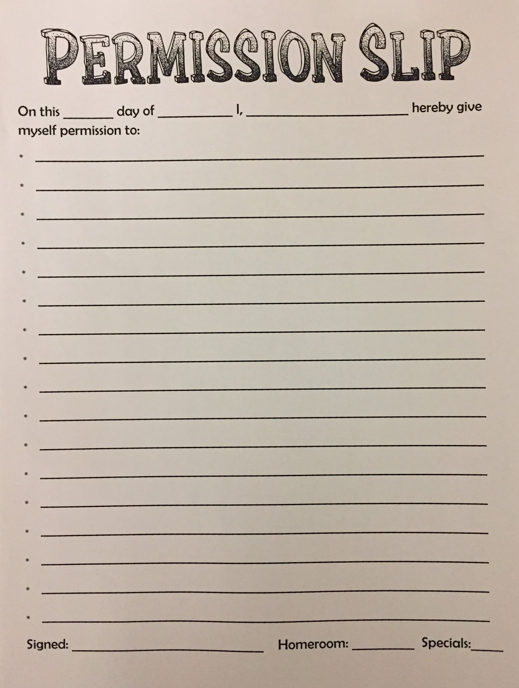
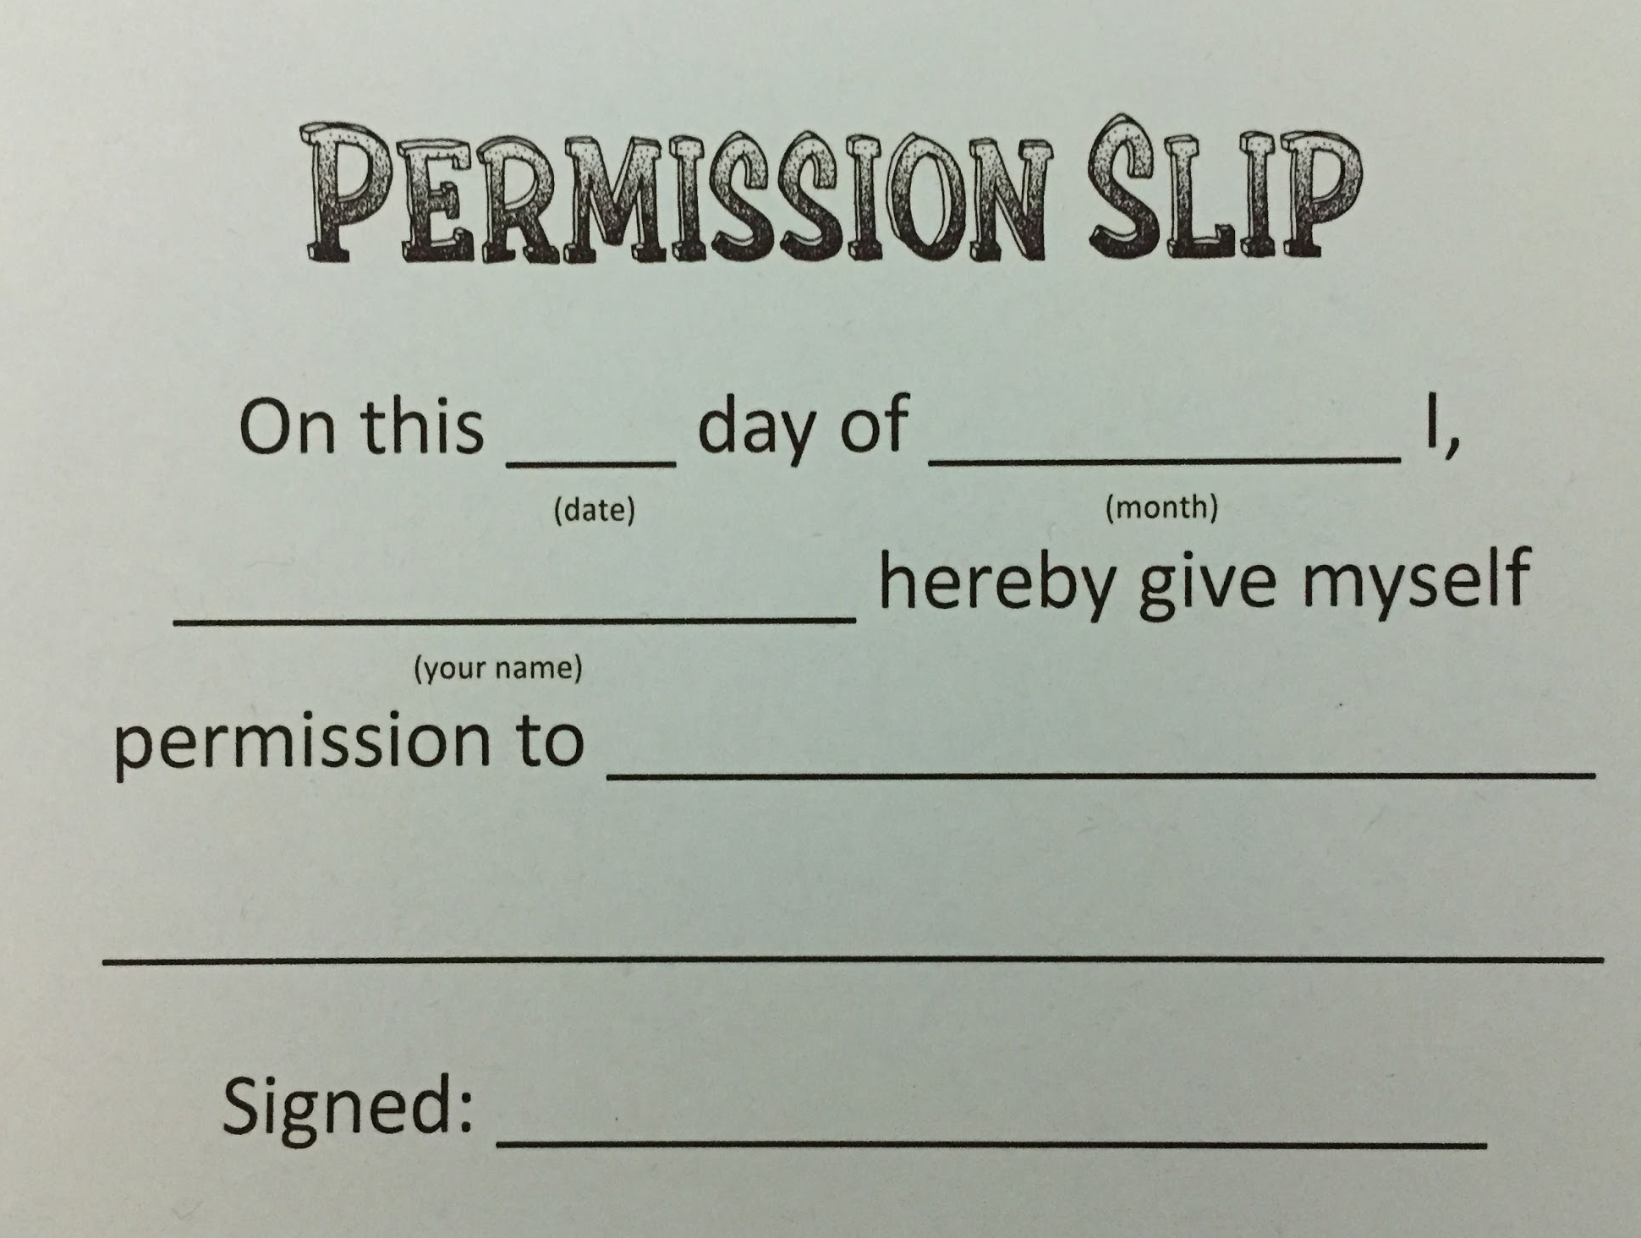

Slide 15
Permission Slips:
I can give myself permission to…
Make spelling errors
Breathe when facing a challenge
Try again
Finish a project even if it isn’t perfect
What else?

Slide 16
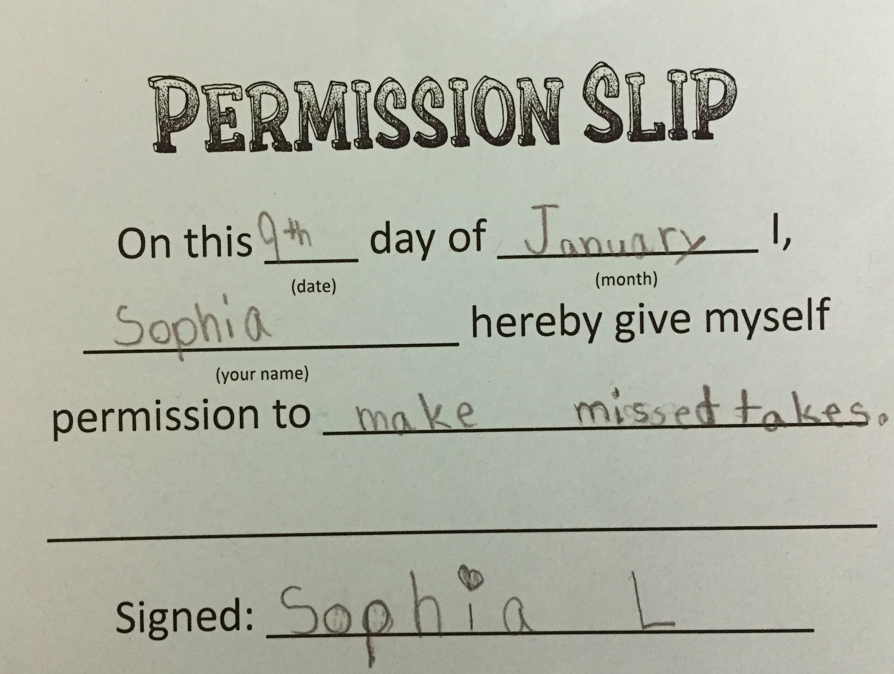
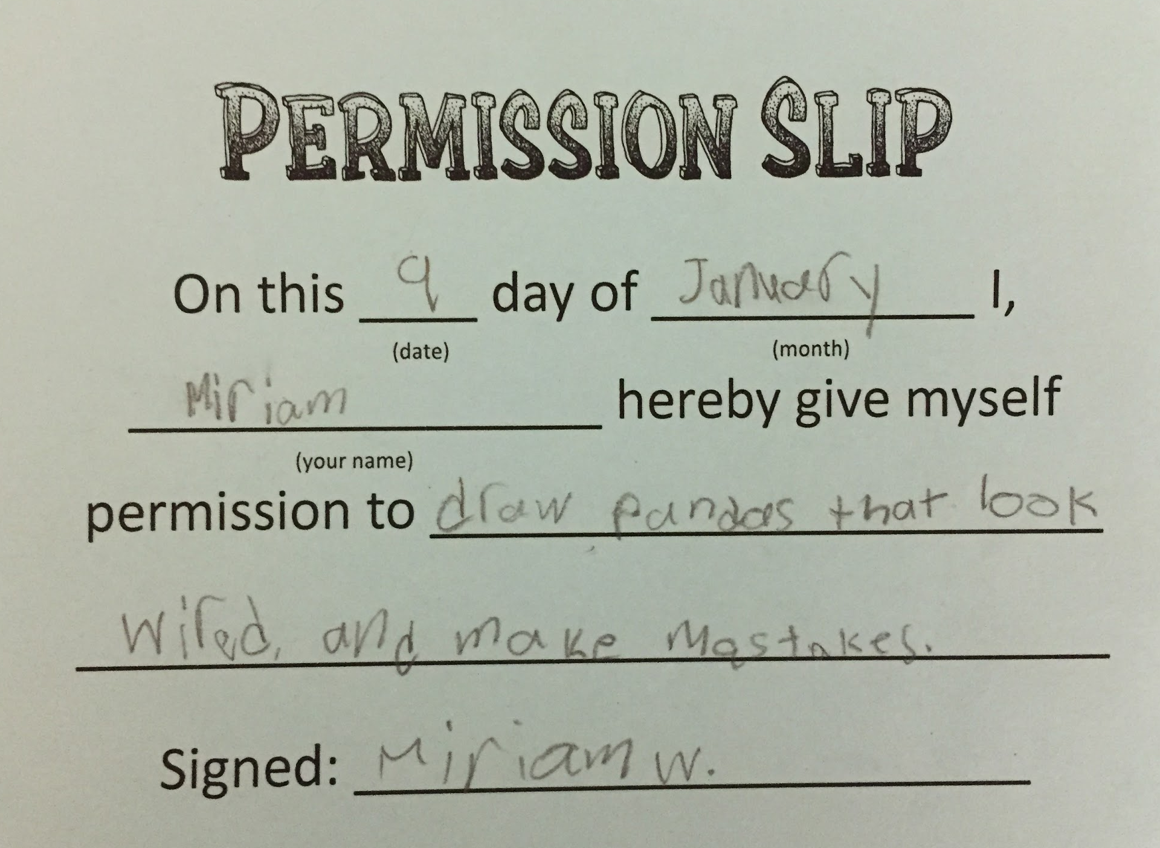
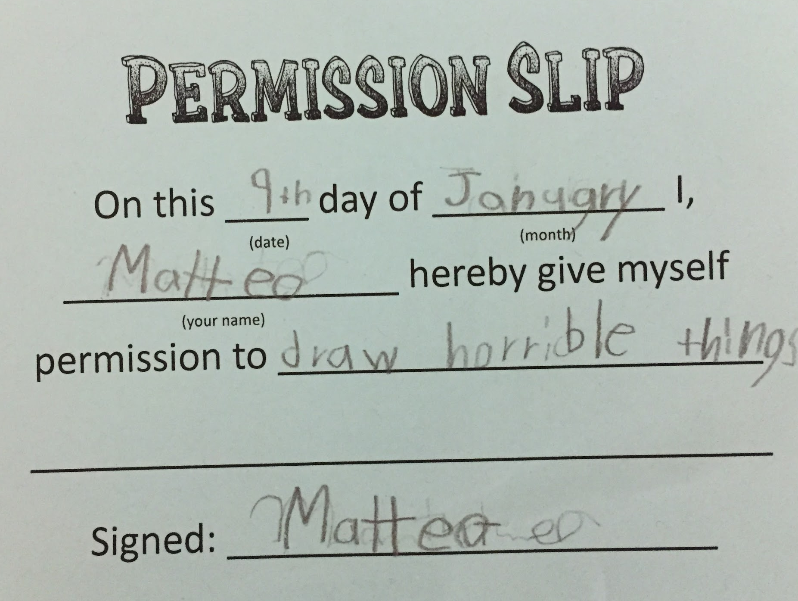
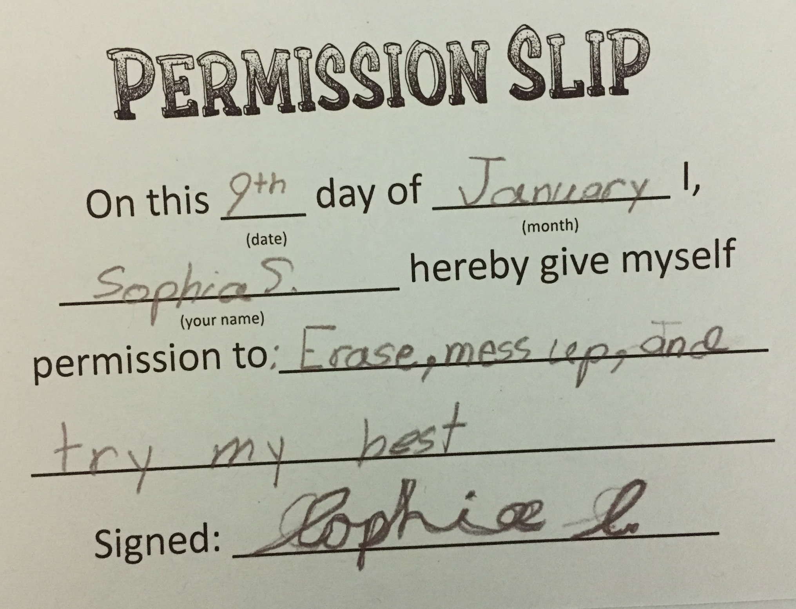

Slide 17
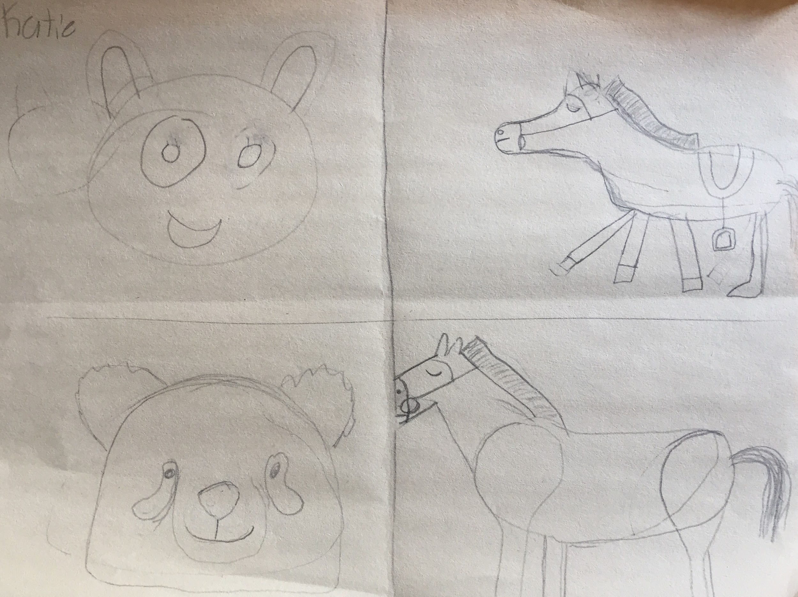

Slide 18
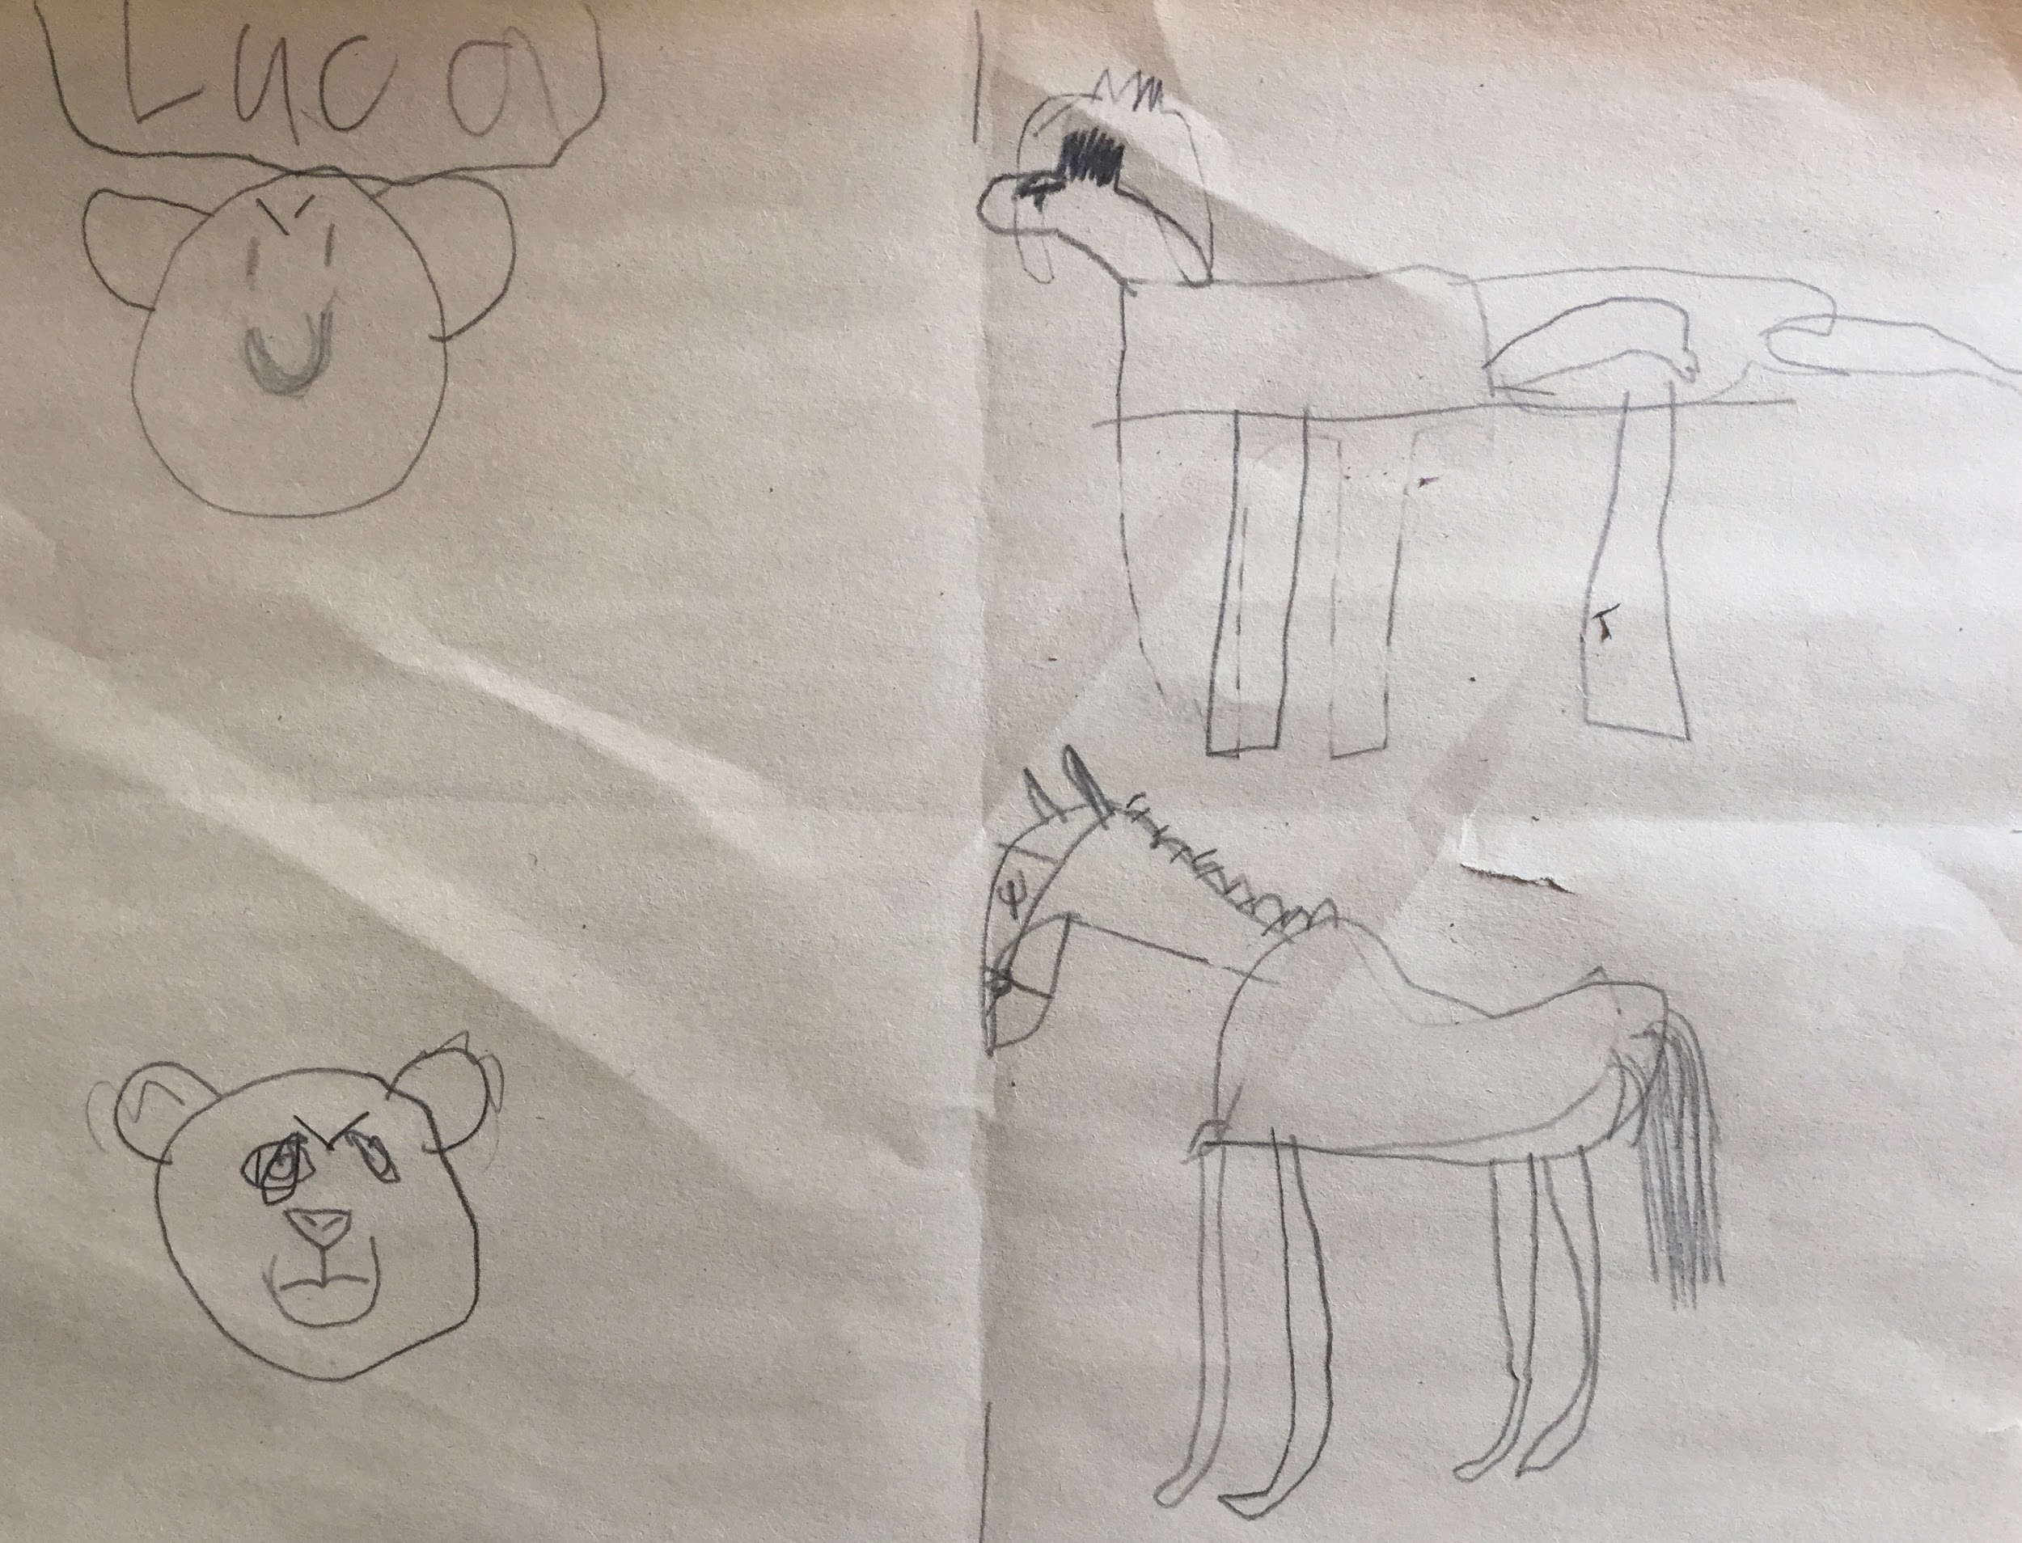

Slide 19
